Slide 1
OAuth 2.0 Framework
Oracle Customer Success Services

Slide 2
OAuth 2.0 Authorization Framework
Introduction
OAuth 2.0 is an authorization framework that enables third-party applications to obtain access to an HTTP Service on behalf of a user, ensuring secure token-based communication.
Industry Standard
Grant Type
OAuth 2.0 is widely considered the best industry standard for secure access to resources, particularly in the context of web APIs and third-party integrations. It leverages tokens to manage and control access, offering a robust and flexible solution for various scenarios.
The Client Credentials Grant type in OAuth 2.0 is a method used by applications to authenticate themselves (not on behalf of a user) and obtain an access token to access protected resources.

Slide 3
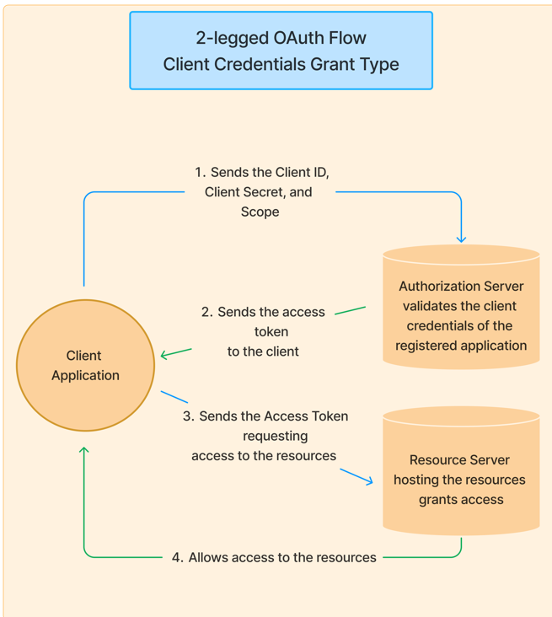
OAuth 2.0 Authorization Framework - Mechanism
Client : The client is the system that requires access to the protected resources. To access resources, the Client must hold the appropriate Access Token.
Authorization Server: This server receives requests from the Client for Access Tokens and issues them upon successful authentication and consent by the Resource Owner.
Resource Server: A server that protects the user’s resources and receives access requests from the Client. It accepts and validates an Access Token from the Client and returns the appropriate resources to it.

Slide 4




OAuth 2.0 Authorization Framework – Key Benefits
Enhanced Security
Granular Access Control
Flexibility and Adaptability
Industry Standardization
OAuth 2.0 relies on access tokens instead of sharing user credentials directly, minimizing the risk of password exposure.
It allows users to specify which resources a third-party application can access, enhancing control over their data.
It supports various authorization flows, making it suitable for different types of applications, including web, mobile, and native apps.
OAuth 2.0 is a widely adopted standard, making it easier for developers to integrate with various services and APIs.

Slide 5




OAuth 2.0 Authorization Framework – Key Benefits
Improved User Experience
Reduced Development Complexity
Scalability
User Control
By reducing the need to create and manage multiple usernames and passwords, OAuth 2.0 simplifies the user experience.
OAuth 2.0 is designed to handle large numbers of users and requests, making it suitable for large-scale applications.
Users retain control over their data and can revoke access to third-party applications at any time.
OAuth 2.0 eliminates the need for complex request signing procedures, making it simpler for developers to implement and manage.

Slide 6
CPM Monitoring Enablement using OAuth 2.0 Authorization Framework
OAuth Provisioning for monitoring Critical Jobs can be provided in the following manner.
Standalone Provisioning - Can be provided without any dependency on Oracle Monitoring Tools.
Oracle Monitoring Tools - Configuration can be done during deployment of one of the below services.
Gen 3 ESS Dashboard
OIC Automated Alerts
Business Process Heatmap
Applications requiring OAuth 2.0 Access
Oracle SaaS Application.
Oracle Integration Cloud.
Pre-requisites
Administrative access to OCI Console.

Slide 7
An end slide on light showing an Oracle logo

